Slide 1
Unit-1
Prepared By:
Prof. Vishal A. Polara
Assistant Professor
Information Technology Department
Birla Vishvakarma Mahavidyalaya Engineering College

Slide 2
Outline
Data Communication
Networks
Protocols and Standards
Standard Organizations
Line Configuration
Topology
Transmission Modes
Categories of Networks
OSI model & TCP/IP model
Example network: The internet, X.25, Frame Relay

Slide 3
Data Communication
Data Communication
Data refers to information presented in whatever form is agreed upon by the parties creating and using the data.
Data Communications are the exchange of data between two devices via some form of transmission medium such as wire cable.
Characteristics of Data Communication
Delivery – The system must deliver data to the correct destination.
Accuracy –The system must deliver data accurately.
Timeliness – The system must deliver data in a timely manner.
Jitter – Jitter refers to the variation in the packet arrival time. For example Video data must deliver in proper time.

Slide 4
Components
Message: The message is the information to be communicated.
Sender: The sender is the device that sends the data message.
Receiver: The receiver is the device that receives the message.
Transmission Medium: It is the physical path by which a message travels from sender to receiver.
Protocol: It is a set of rules that govern data communication.
Data Representation
Text, Numbers, Images, Audio,Video

Slide 5
Components of data communication

Slide 6
2. Networks Performance Criteria
Data Communi-cation Network Criteria
Performance
Reliability
Security
Transit time
Response time
Throughput
Delay
Frequency of Failure
Unauthorization
Time taken by a link to recover
Policy implementation for Recovery measures
Protecting data from Damage

Slide 7
3. Protocols & Standards
What is Protocol?
It is a set of rules that govern data communications.
It defines
what is communicated
how it is communicated
when it is communicated
Key elements of a protocol are:
Syntax (presentation or structure or format of the data)
Semantics (How a particular pattern is to be interpreted, and what action is to be taken)
Timing (when data should be sent and how fast they can be sent)

Slide 8
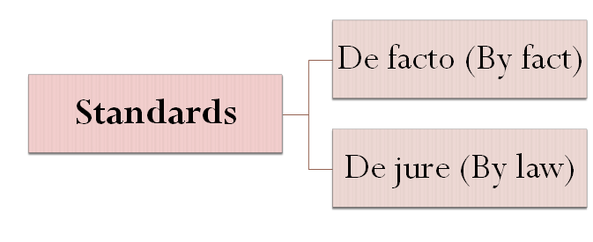
3. Protocols & Standards (Contd.)

Slide 9
4. Standard Organizations
Standards Creation Committees formed by:
Forums (work with universities and users to test, evaluate, and standardize new technologies)
Regulatory Agencies (to protect the public interest by regulating radio, television, and wire/cable communications)
Internet Standards (It is a formalized regulation that must be followed)
Some Standards Creation Committees are:
International Organization for Standardization (ISO)
International Telecommunication Union-Telecommunication Standards Sector (ITU-T)
American National Standards Institute (ANSI)
Institute of Electrical and Electronics Engineers (IEEE)
Electronic Industries Association (EIA)

Slide 10
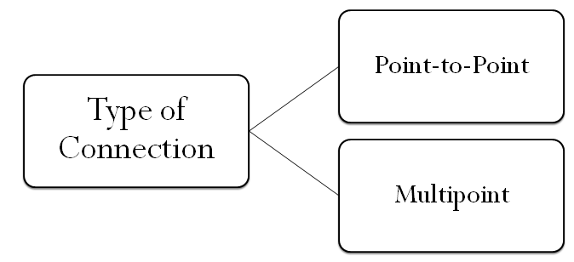
5. Line Configuration

Slide 11
Point to Point
- A point to point connection provides a dedicated link between two devices. The entire capacity of the link is reserved for transmission between those two devices.
Multipoint
- A multipoint connection is one in which more than two specific devices share a single link. Capacity of channel is shared either spatially or temporally.

Slide 12
Point-to-Point Line Configuration

Slide 13
Point-to-Point Line Configuration

Slide 14
Point-to-Point Line Configuration

Slide 15
Multipoint Line Configuration

Slide 16
6. Transmission Modes
Transmission Modes / Data Flow
Simplex
Half-Duplex
Full-Duplex

Slide 17
Example: Keyboards and traditional monitors
Simplex

Slide 18
Half-Duplex
Example: Walkie-talkies and CB (citizens band) radios

Slide 19
Full-Duplex
Example: Telephone network

Slide 20
7. Topology
Physical Topology
Mesh
Star
Bus
Ring
Tree
Hybrid

Slide 21
Mesh Topology
The Topology of a network is the geometric representation of the relationship of all the links and linking devices(usually called nodes) to one another.
In mesh topology every device has a dedicated point to point link to every other device.
Each node is connected to n-1 node so we need n(n-1) link.
If each physical link allows communication in both directions then we need n(n-1)/2 link duplex mode links.

Slide 22
Mesh Topology

Slide 23
Advantages:
Data can be transmitted from different devices simultaneously. This topology can stand with high traffic.
Even if one of the components fails there is always an alternative present. So data transfer doesn’t get affected.
Expansion and modification in topology can be done without disrupting other nodes.
Disadvantages:
There are high chances of redundancy in many of the network connections.
Overall cost of this network is way too high as compared to other network topologies.
Set-up and maintenance of this topology is very difficult. Even administration of the network is tough.

Slide 24
Star Topology
In star topology each device has a dedicated point to point link only to a central controller usually called hub.
Star topology does not allow direct traffic between devices.
A Controller act as an exchange.

Slide 25
Star Topology

Slide 26
Advantage:
Easy to install and wire.
No disruptions to the network when connecting or removing devices.
Easy to detect faults and to remove parts.
Disadvantage:
Requires more cable length than a linear topology.
If the hub, switch, or concentrator fails, nodes attached are disabled.
More expensive than linear bus topologies because of the cost of the hubs, etc.

Slide 27
Bus Topology
One long cable acts as a backbone to link all the devices in a network.
Nodes are connected to the bus cable by drop lines and taps.
A drop line is a connection running between the device and the main cable.
As single travels through cable heat generated so there is a limitation of tap on cable at some distance.

Slide 28
Bus Topology

Slide 29
Advantages:
It is easy to set-up and extend bus network.
Cable length required for this topology is the least compared to other networks.
Bus topology costs very less.
Linear Bus network is mostly used in small networks. Good for LAN.
Disadvantage:
Entire network shuts down if there is a break in the main cable.
Terminators are required at both ends of the backbone cable.
Difficult to identify the problem if the entire network shuts down.
Not meant to be used as a stand-alone solution in a large building.

Slide 30
Ring Topology
In a ring topology each device has a dedicated point to point connection with only the two devices on either side of it.
Signal is passed along the ring in one direction from device to device until it reaches its destination.
Each device in the ring incorporates a repeater.

Slide 31
Ring Topology

Slide 32
Advantages:
It is easy to install and reconfigure.
in ring topology all the traffic flows in only one direction at very high speed.
It also has alarm system to inform failure of device.
There is no need for network server to control the connectivity between workstations.
Additional components do not affect the performance of network.
Each computer has equal access to resources.
Disadvantages:
Each packet of data must pass through all the computers between source and destination. This makes it slower than Star topology.
If one workstation or port goes down, the entire network gets affected.
Network is highly dependent on the wire which connects different components.
MAU’s ( Multistation Access Unit and network cards are expensive as compared to Ethernet cards and hubs

Slide 33
Hybrid Topology

Slide 34
Advantages
Reliable : Unlike other networks, fault detection and troubleshooting is easy in this type of topology.
Scalable: Its easy to increase the size of network by adding new components, without disturbing existing architecture.
Flexible: Hybrid Network can be designed according to the requirements of the organization and by optimizing the available resources.
Effective: Hybrid topology is the combination of two or more topologies, so we can design it in such a way that strengths of constituent topologies are maximized while there weaknesses are neutralized.
Disadvantages
Complexity of Design: One of the biggest drawback of hybrid topology is its design. Its not easy to design this type of architecture and its a tough job for designers. Configuration and installation process needs to be very efficient.
Costly Hub: The hubs used to connect two distinct networks, are very expensive.
Costly Infrastructure: As hybrid architectures are usually larger in scale, they require a lot of cables, cooling systems, sophisticate network devices, etc.

Slide 35
Tree Topology

Slide 36
Advantages:
Point-to-point wiring for individual segments.
Supported by several hardware and software venders.
Disadvantages:
Overall length of each segment is limited by the type of cabling used.
If the backbone line breaks, the entire segment goes down.
More difficult to configure and wire than other topologies.

Slide 37
8. Categories of Networks
LAN
(Local Area Network)
WAN
(Wide Area Network)
MAN
(Metropolitan Area Network)
Three Categories of Networks

Slide 38
Local Area Network

Slide 39
Local Area Network

Slide 40
Metropolitan Area Network

Slide 41
Wide Area Network

Slide 42
Internetwork
(Internet)

Slide 43
9. OSI Model
ISO is the organization. OSI is the model.
Before 1990 OSI(Open Systems Interconnection) Model.
Now a days TCP/IP is used because it tested extensively in the internet.
An open system is a set of protocols that allows any two different systems to communicate regardless of their underlying architecture.
OSI model provide communication without changing the logic of the underlying hardware and software.
The processes on each machine that communicate at a given layer are called peer to peer processes.

Slide 44
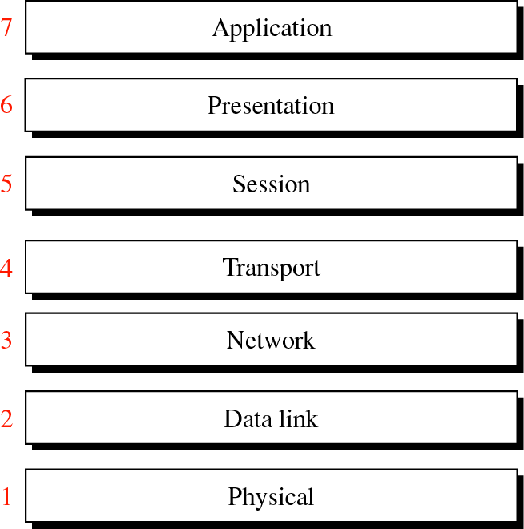
OSI Model

Slide 45
OSI layer
Layers 1,2 and 3 includes physical, datalink and network are th e network support layers.
They deal with the physical aspects of moving data from one device to another.
Layer 5,6 and 7 include session, presentation and application can be thought of as the user support layers they allow interoperability among unrelated software system.
Layer 4 the transport layer links the two subgroups and ensure that what the lower layers have transmitted.
The upper OSI layers are almost software, Lower layers are combination of hardware and software, except physical it is always hardware.

Slide 46
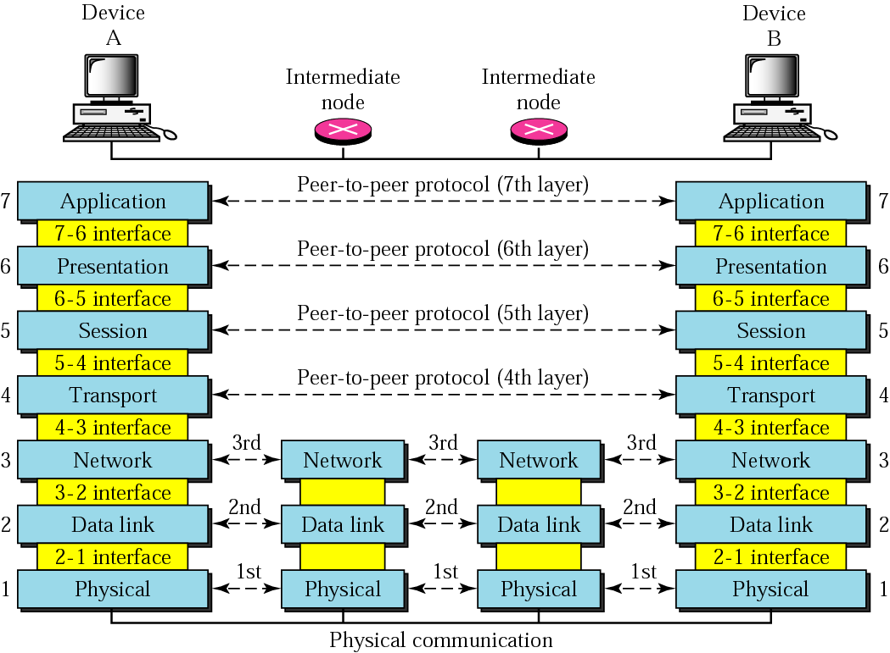
OSI layers

Slide 47
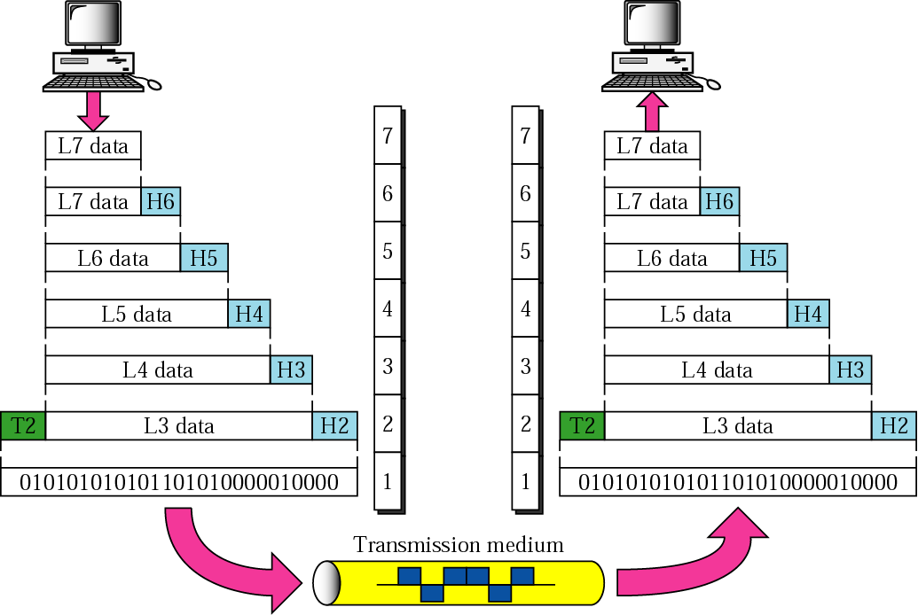
An exchange using the OSI model

Slide 48
Physical Layer
The physical layer coordinates the functions required to carry a bit stream over a physical medium.
It deals with mechanical and electrical specification of the interface and transmission medium.
The physical layer is responsible for movements of individual bits from one hop to the next.
Task of physical layer:
Physical characteristics of interfaces and medium:
Representation of bits: It contain message in the form of 0 or 1 which is encoded into signals(electrical or optical).
Data Rate: The transmission rate the number of bits sent each second.

Slide 49
Physical Layer
4. Synchronization of bits: The sender and receiver clock must be synchronized.
5. Line configuration
6. Physical Topology
7. Transmission Modes

Slide 50
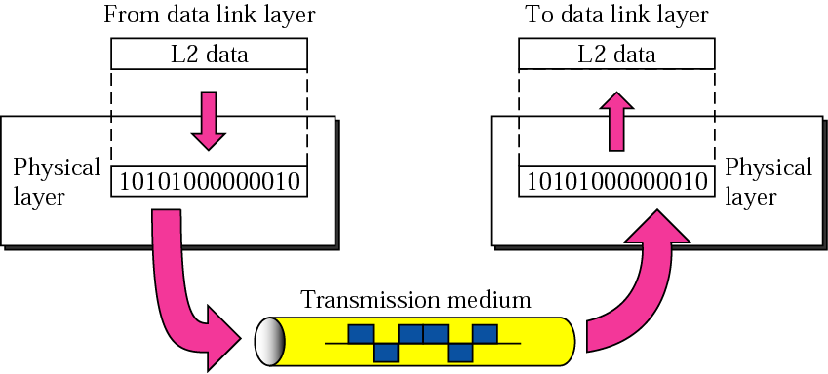
Physical Layer

Slide 51
Data link Layer
The data link layer transforms the physical layer a raw transmission facility to a reliable link.
It is responsible for moving frames from one hop(node) to the next.
Task of data link layer:
Framing: It divides the stream of bits received from the network layer into manageable data units called frames.
Physical Addressing: It adds a header to the frame to define the sender or receiver of the frame.
Flow Control: The rate of consuming data and sending data maintain by data link layer.
Error Control: It provide mechanisms to detect and retransmit damaged or lost frames.
Access Control: It provide information of the device which has control over the link.

Slide 52
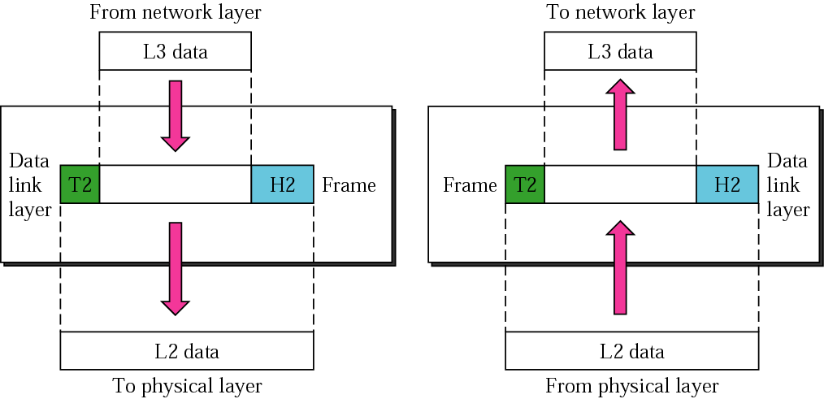
Data Link Layer

Slide 53
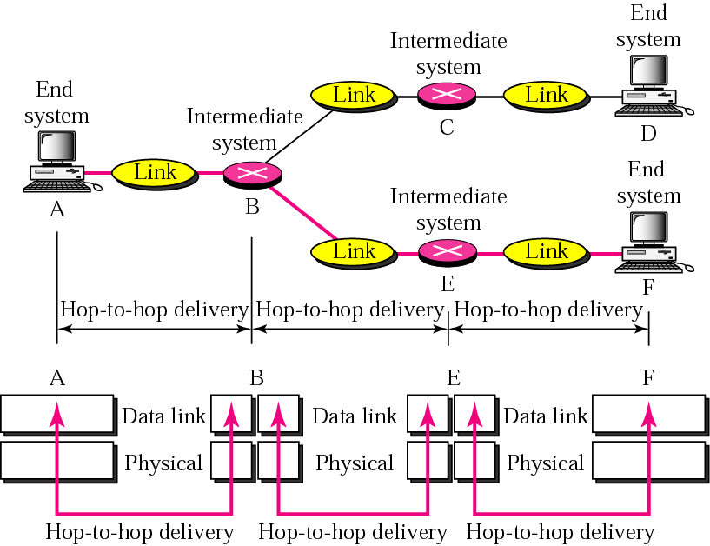
Node-to-node delivery

Slide 54
Network Layer
It is responsible for the source to destination delivery of a packet.
It deliver packet possible across multiple networks(links).
There is no requirement of network layer if there is direct link between two devices.
Task of Network Layer:
Logical Addressing: Example IP address
Routing: When an independent networks or links are connected to create internetworks or a large network the connecting devices called router.

Slide 55
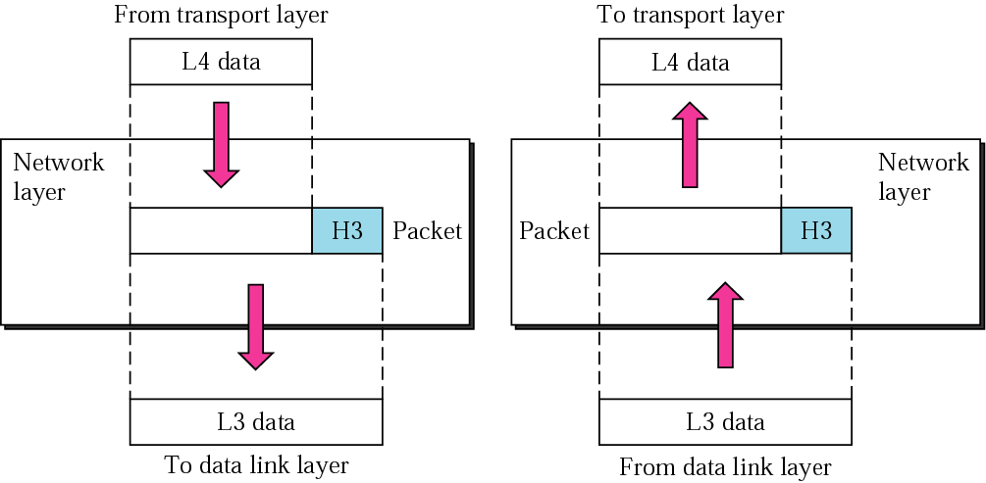
Network Layer

Slide 56
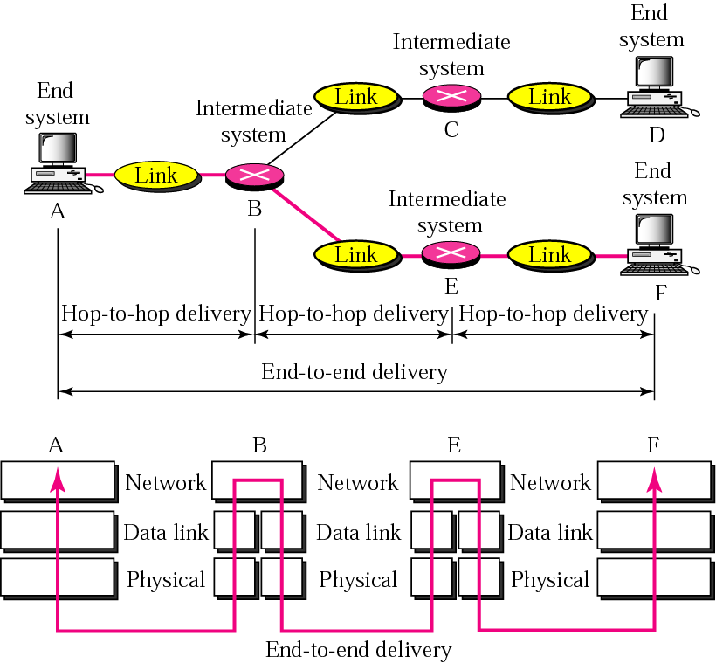
End-to-end delivery

Slide 57
Transport Layer
It is responsible for process to process delivery of the entire message.
Task of Transport Layer:
Service Point Addressing: It is responsible for delivery from process to process so it contain service point address.
Segmentation and reassemble: Dividing message into segment and assign number to each segment so properly collect it at receiving end.
Connection Control: It provide two types of service, connection less or connection oriented.
Flow control: It is responsible for delivery end to end rather than across a single link.

Slide 58
Transport Layer
5. Error Control: Error control is end to end rather than across a single link. Error correction is done by means of retransmission.

Slide 59
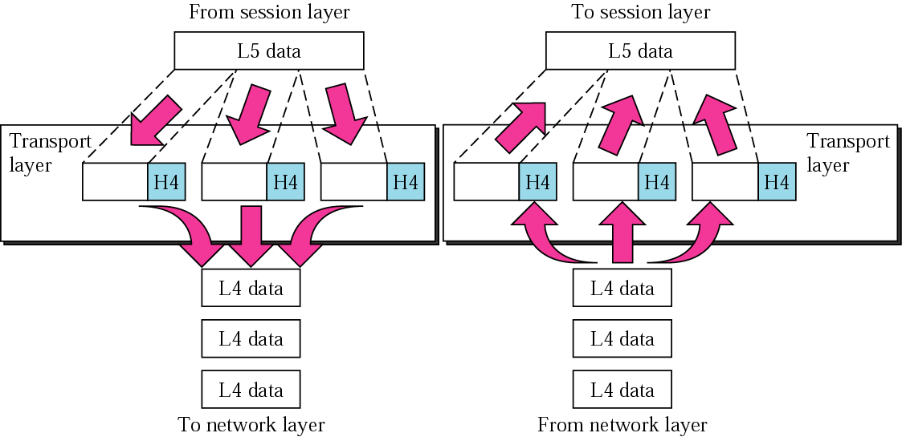
Transport Layer

Slide 60
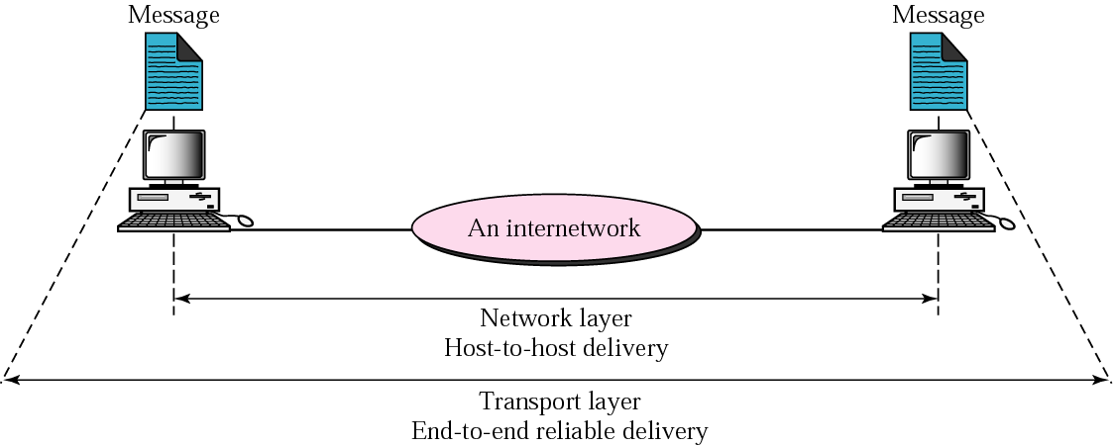
Reliable end-to-end delivery of a message

Slide 61
Session Layer
It is responsible for dialog control and synchronization.
Task of Session Layer:
Dialog Control: It allows two systems to enter into a dialog. It allows system to make half duplex or full duplex communication.
Synchronization: The session allows a process to add checkpoints, to a stream of data. For example if we are sending 1000 file it is good to put checkpoint to make recovery possible.

Slide 62
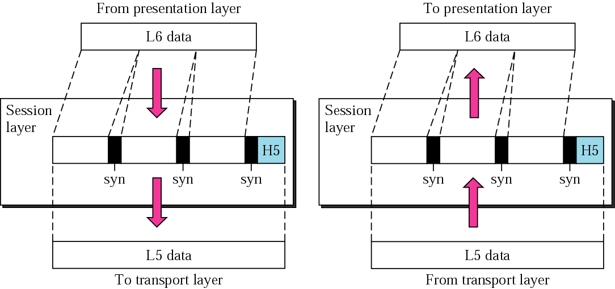
Session Layer

Slide 63
Presentation Layer
It is responsible for Translation, Compression and Encryption.
Task of Presentation Layer:
Translation: It is responsible for translation of different encoding systems.
Encryption: It is responsible to encrypt a file to maintain privacy.
Compression: It is responsible to reduce a number of bits by using compression technique.t

Slide 64
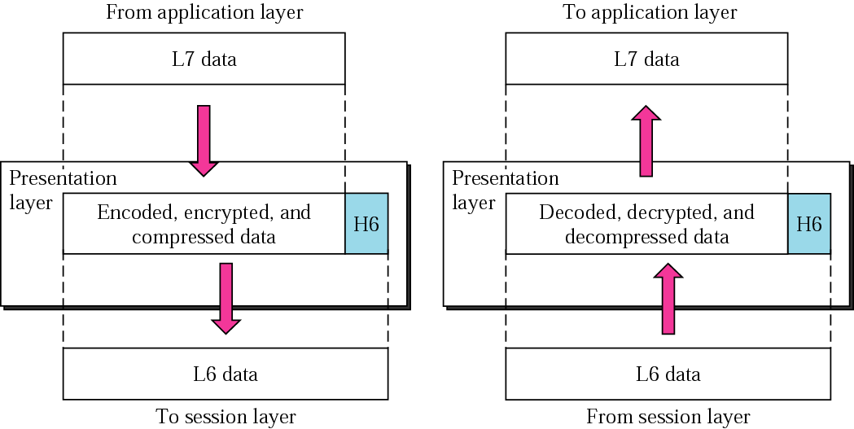
Presentation Layer

Slide 65
Application Layer
It is responsible for providing service to users.
It provide user interface and support for services such as electronic mail, remote file access and transfer
Task of Presentation Layer:
Network Virtual Terminal: It is a software version of a physical terminal, and it allows a user to log on to a remote host.
File Transfer, Access and mgmt: It allows user to access file from remote host.
Mail service and directory service: It provide service for mail and to access for global information.

Slide 66
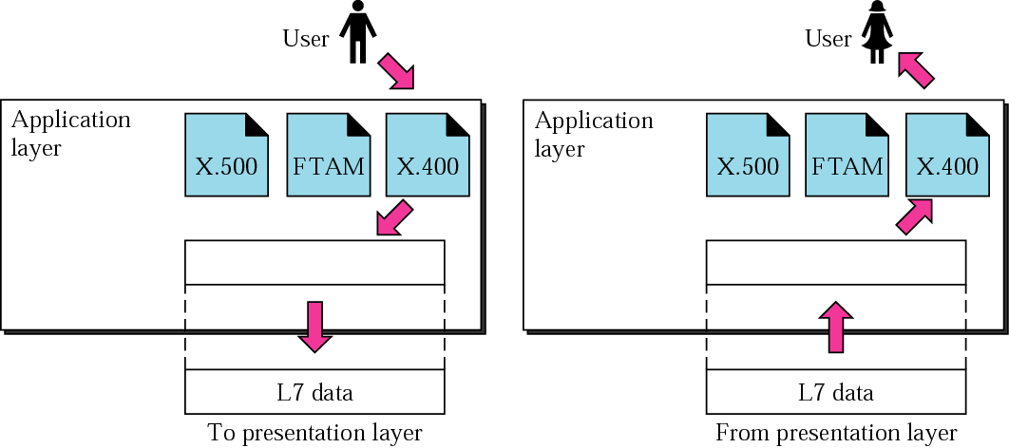
Application Layer

Slide 67
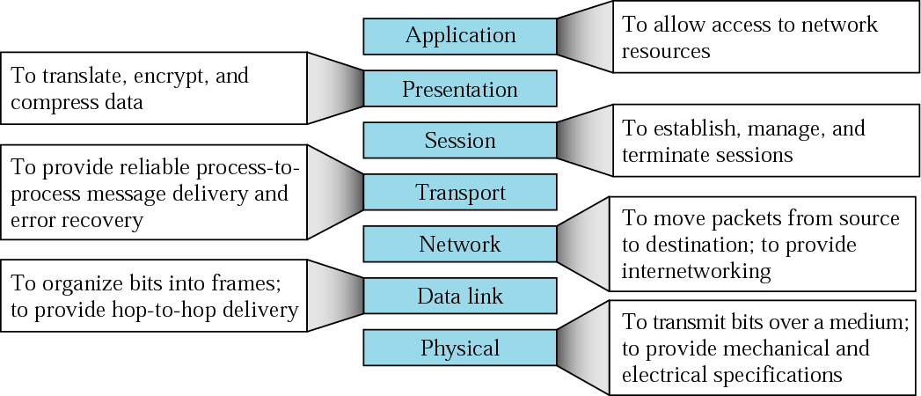
Summary of layers

Slide 68
OSI Model in Short

Slide 69
Connection Oriented Services | Connection Less Services
A connection is to be established before starting the communication | Each message is routed independently from source to destination
Authentication is needed | Does not need any authentication
Makes a connection and checks whether message is received or not and sends again if an error occurs | Does not guarantees a delivery
More reliable than connectionless service | Less reliable than connection oriented service
Connection oriented service interface is stream based | Connectionless service is message based

Slide 70
TCP/IP PROTOCOL SUITE
The layers in the TCP/IP protocol suite do not exactly match those in the OSI model.
The original TCP/IP protocol suite was defined as having four layers: host-to-network, internet, transport, and application.
However, when TCP/IP is compared to OSI, we can say that the TCP/IP protocol suite is made of five layers: physical, data link, network, transport, and application.
OSI model specifies which functions belong to each of its layers while TCP/IP protocol suite contain relatively independent protocols.

Slide 71
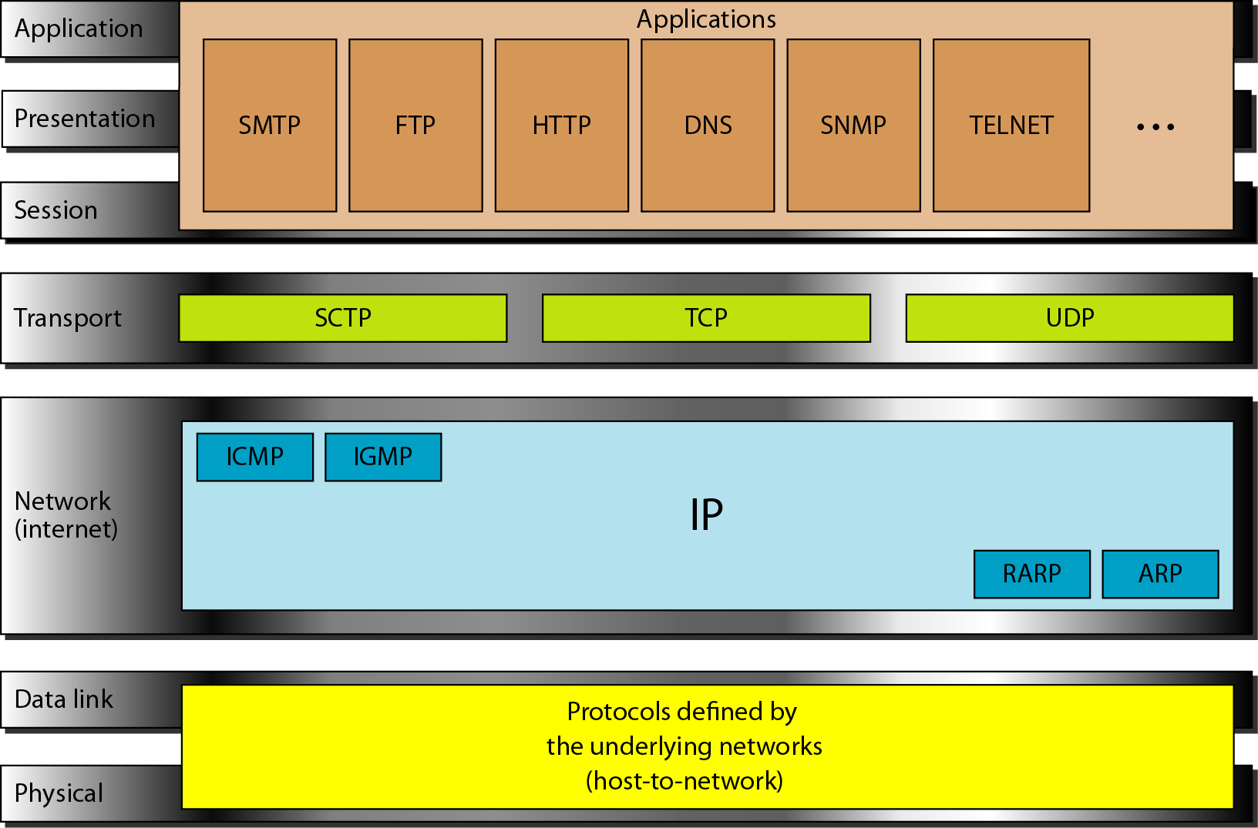
TCP/IP and OSI model

Slide 72
Physical and Data link Layer
There is no separate protocol for this two layere.
It supports all the standard and proprietary protocols.

Slide 73
Network Layer
It supports IP (Internetworking Protocol) in turn uses four supporting protocols: ARP, RARP, ICMP and IGMP
Internetworking Protocol(IP):
It is an unreliable and connectionless protocol.
IP transports data in packets called datagrams, each of which is transported seperately.
IP doesnot have record keeping facility.
Address Resolution Protocol(ARP):
It is used to convert logical address into physical address.
Each device is usually identified using network interface card.

Slide 74
Network Layer
Reverse Address Resolution Protocol(RARP):
It is used to convert physical address into logical address.
Internet Control Message Protocol(ICMP):
It is a mechanism used by hosts and gateways to send notification of datagram problems back to the sender.
It sends query and error reporting messages.
Internet Group Message Protocol(IGMP):
It is used to facilitate the simultaneous transmission of a message to a group of recipients.

Slide 75
Transport Layer
It has three protocol TCP,UDP and SCTP
User Datagram Protocol:
It is connection less protocol.
It adds only port addresses, checksum, error control and length information to the data from the upper layer.
Transmission Control Protocol:
It is reliable stream transport protocol. Stream means connection oriented.
A connection must be established between both ends of a transmission before either can transmit data.
Stream Control Transmission Protocol:
It provides support for voice over the internet.

Slide 76
Application Layer
It is equivalent to the combined session, presentation and application layers in OSI model.

Slide 77
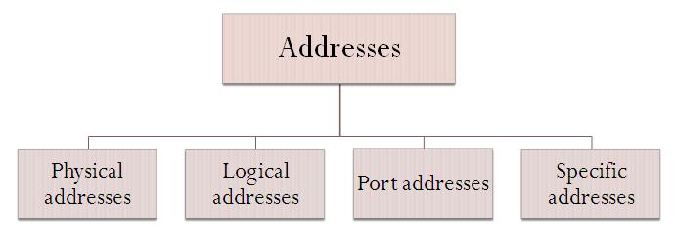
Addresses in TCP/IP

Slide 78
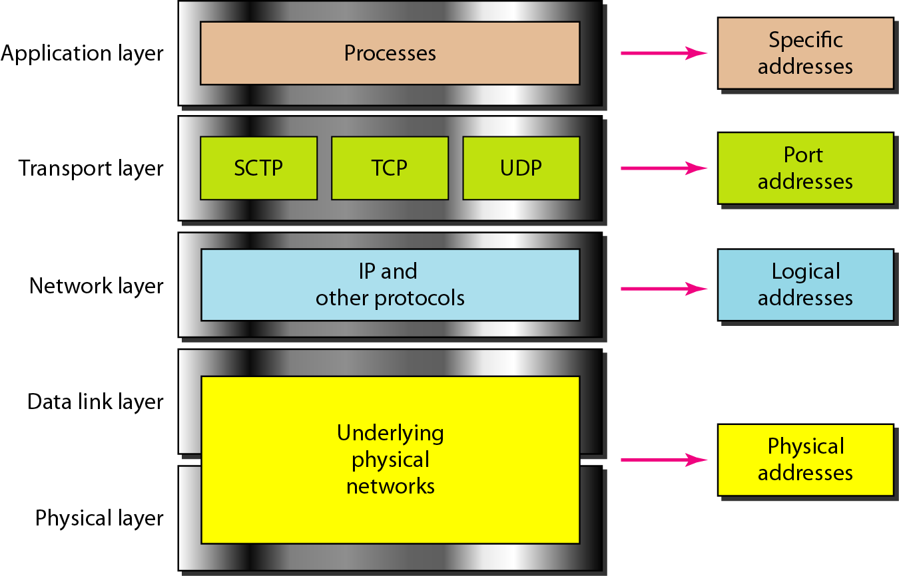
Relationship of layers and addresses in TCP/IP

Slide 79
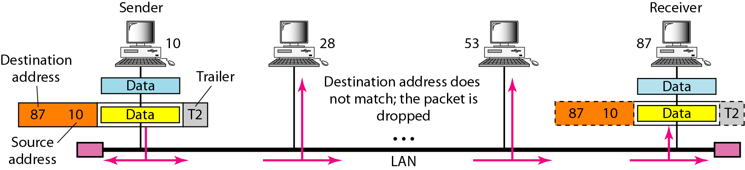
Physical Addresses
It is also known as link address. It is included in frame by data link layer.
It use 6 byte (48bit) physical address.
Example 1 - Physical addresses

Slide 80
Example 2
Most local-area networks use a 48-bit (6-byte) physical address written as 12 hexadecimal digits; every byte (2 hexadecimal digits) is separated by a colon, as shown below:
07:01:02:01:2C:4B
A 6-byte (12 hexadecimal digits) physical address.

Slide 81
Logical Addresses
It is necessary for universal communication that are independent of underlying physical networks.
It is needed to indentify each host uniquely.
It is of 32 bit.
Physical address changes from hope to hope.

Slide 82
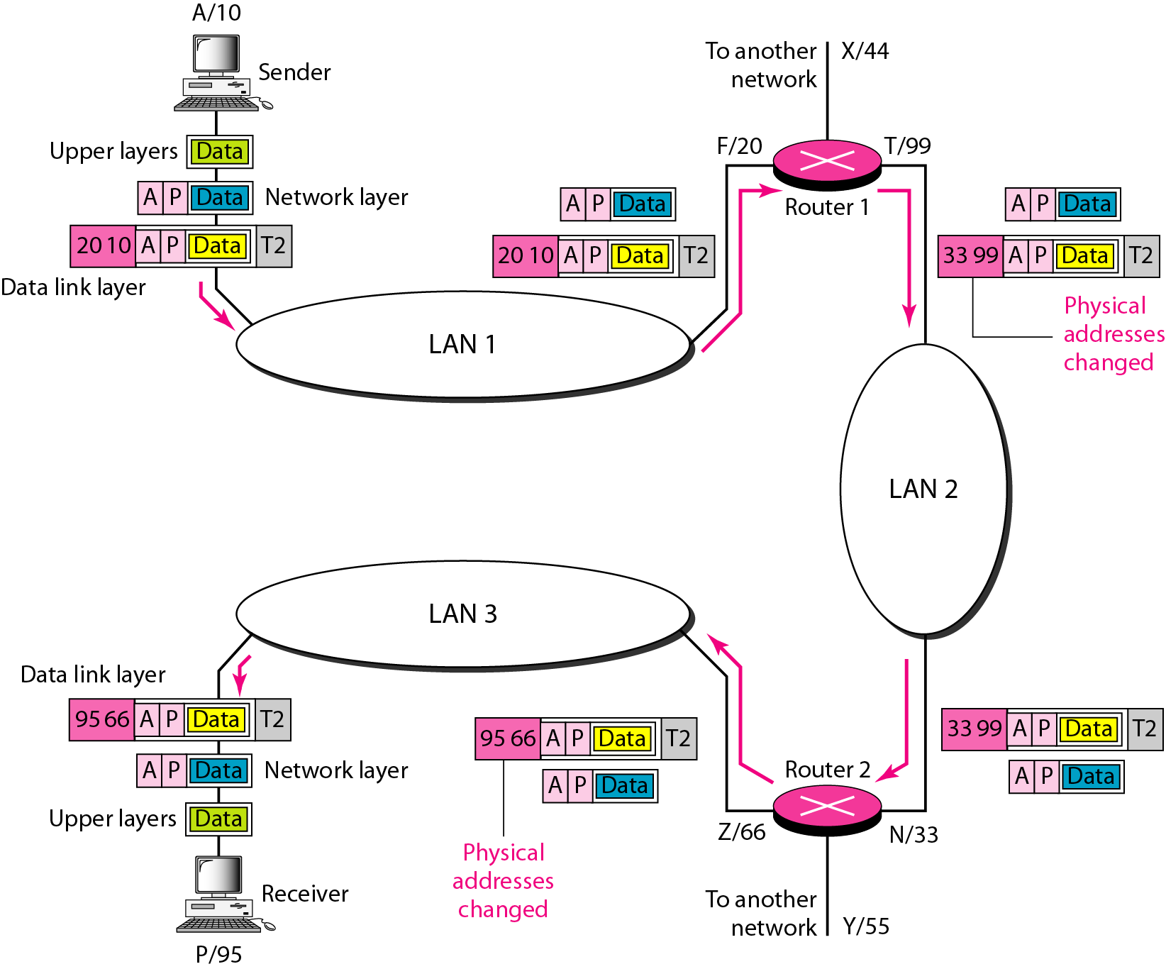
Example 3: IP addresses

Slide 83
Port Address
It is of 16 bits.
It requires for communication of individual process independently.

Slide 84
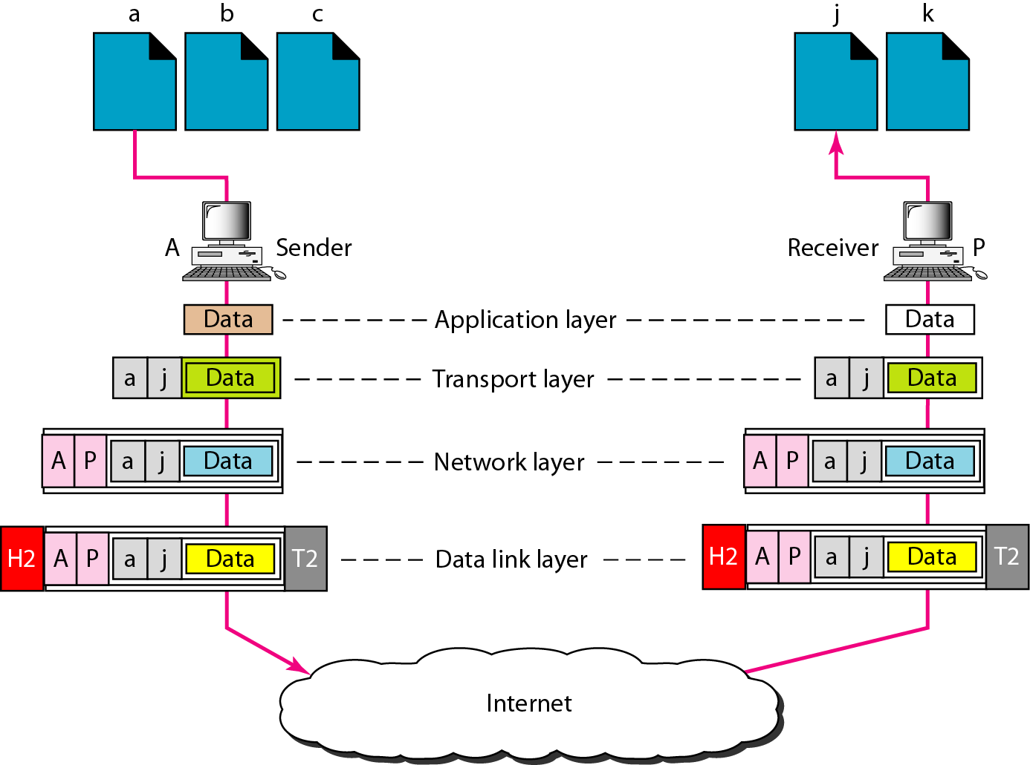
Example 4: Port addresses

Slide 85
A port address is a 16-bit address represented by one decimal number as shown.
Example 5
753
A 16-bit port address represented as one single number.

Slide 86
The physical addresses change from hop to hop, but the logical and port addresses usually remain the same.
Addresses | Address Length
Physical Address | 48 bits
Logical Address | 32 bits
Port Address | 16 bits

Slide 87
Specific Addresses:
Some applications have user-friendly addresses that are designed for that specific address.
Example : the e-mail address (for example, forouzan@fhda.edu) and the Universal Resource Locator (URL) (for example, www.mhhe.com).
The first defines the recipient of an e-mail
The second is used to find a document on the World Wide Web.
These addresses get changed to the corresponding port and logical addresses by the sending computer.

Slide 88
OSI v/s TCP/IP

Slide 89
Example Networks
Internet
X.25
Frame Relay

Slide 90
Internet
International ISP:
Connect nations (IANA(internet assign number authority))
National ISP:
Backbone networks are connected by NAP (Network Access Points)
Regional ISP:
They are connected to one or more national ISPs
Local ISP:
They provide direct service to end users
Each local ISP can be connected to a regional or national ISP
It can be a
company providing Internet services
corporation with a network providing services to own employees
nonprofit organization like college or university running their own network

Slide 91
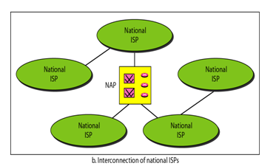
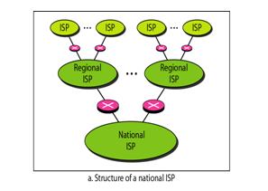
Hierarchical organization of the Internet

Slide 92
Thank You

